Slide 1
Service For Seniors Empowering Independent Living
Submitted By
Team 8
Team Members | Mail ID
Sumit Valecha | svalecha91@gmail.com
Ashish Narkhede | ashish12021@gmail.com
Mansi Shah | mansishah8488@gmail.com
Yash Oswal | yashoswa990@gmail.com
Neeraj Gupta | neeraj.1286@gmail.com
Shreedhar Pawar | shreedhar22@gmail.com

Slide 2
Your loved ones want to live at home and you know that’s best. But you worry about them. An independent life has a rhythm of its own. The big issues appear out of nowhere. Monitoring daily life patterns helps you see small changes that hint at bigger issues, before anyone may think to look at them

Slide 3
Problem Statement
“An easy-to-use emergency monitoring and reporting ecosystem that can connect the senior citizens and there care takers remotely. by just minimum intervention from the senior citizens. This system attempts to automatically report the loved ones day-to-day activities and emergency information so that the responsible health providers can take proper urgent actions for the aged people.”
Research indicates that, even with the abundance of available health monitoring apps at our fingertips, our seniors (and even we ourselves) are still primarily using their heads or paper to track and trend their health data.

Slide 4
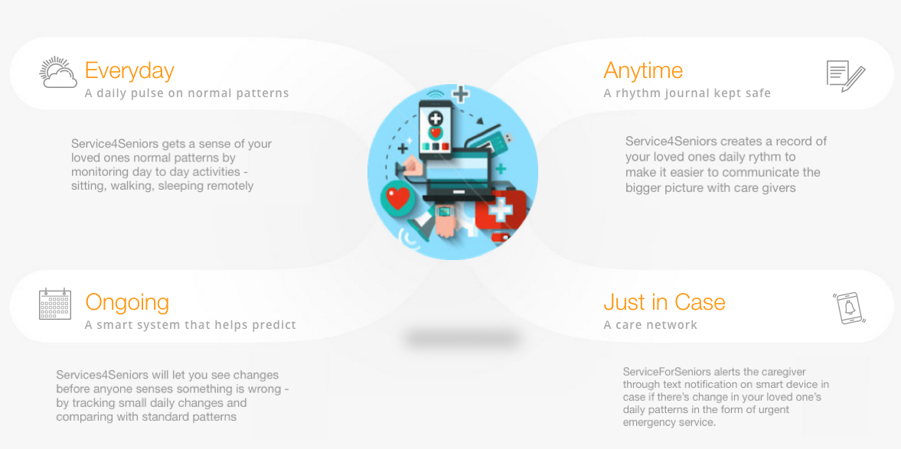
Approach to Solution

Slide 5
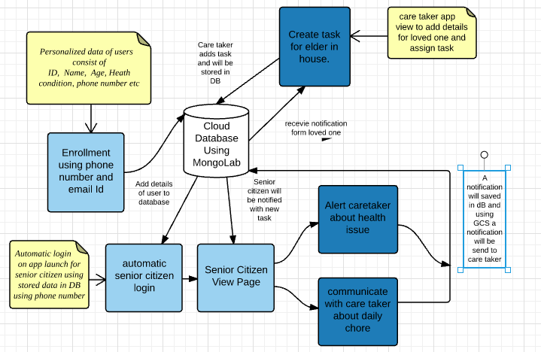
System Flow

Slide 6






Technology Stack

Slide 7
Challenges
Scope decision to build the MVP
Seamless notification service – GCMS
Assistive/Easy user experience for senior citizens
Building a generic architecture to be able to adapt and extend to larger audience

Slide 8
Future Enhancements
Track real time data using wearable's, Bluetooth beacons & communication hub (router)
A smart system to predict abnormalities and trends
Add voice assistance for ease of use
3D skeleton to describe health issues
Font editing facility
Urgent care network enhancement
Track statistics through rich visualization dashboard

Slide 9
DEMO !!

